Slide 1
The Association Between Income and Life Expectancy
in the United States, 2001-2014
Raj Chetty, Stanford
Michael Stepner, MIT
Sarah Abraham, MIT
Shelby Lin, McKinsey
Benjamin Scuderi, Harvard
Nicholas Turner, Office of Tax Analysis
Augustin Bergeron, Harvard
David Cutler, Harvard
The opinions expressed in this paper are those of the authors alone and do not necessarily reflect the views of the Internal Revenue Service, the U.S. Treasury Department, or any other agency of the Federal Government.

Slide 2

Introduction
Well known that higher income is associated with longer life [e.g., Kitagawa and Hauser 1973, Pappas et al. 1993, Williams and Collins 1995, Meara et al., Olshansky et al. 2012, Waldron 2007, 2013]
But several aspects of relationship between income and longevity remain unclear
What is the shape of the income–life expectancy gradient?
How are gaps in life expectancy changing over time?
How do the gaps vary across local areas?
What are the sources of the longevity gap?
Notes:
2

Slide 3
This Paper
We use de-identified data from tax records covering the U.S. population from 1999-2014 to characterize income-mortality gradients
1.4 billion observations → more granular analysis of relationship between income and mortality than in prior work
Characterize life expectancy by income, over time, and across areas
More precise estimates at national level than in prior work
Large and growing gaps in longevity across income groups
New local area estimates by income group
Substantial variation in level and change in life expectancy across areas, especially for the poor
Notes:
3

Slide 4
This Paper
We also characterize correlates of the spatial variation we document
But we do not identify causal mechanisms in this paper
Focus primarily on constructing publicly available statistics
To facilitate future work on mechanisms and to measure progress systematically
Notes:
4

Slide 5
Outline
Data and Methodology
National Statistics on Income and Life Expectancy
Local Area Estimates
Predictors of Local Area Variation
Notes:
5

Slide 6
Part 1: Data and Methodology

Slide 7
Data and Sample Definition
Income data from de-identified 1999-2014 tax returns
Mortality data from SSA DM-1 file
DM-1 death counts are closely aligned with CDC NCHS counts by year and across age distribution (less than 2% difference)
Notes:
7

Slide 8
Income Definition
Baseline income concept: household earnings
For tax filers: Adjusted Gross Income minus Social Security and Disability benefits
For non-filers: W-2 earnings + UI benefits
Exclude individuals with zero household income (8% of population at age 40)
Mortality rates for individuals with zero income measured imperfectly because deaths of non-residents are not tracked fully in SSA data
Focus on percentile ranks in income distribution
Rank individuals in national income distribution within birth cohort, gender, and tax year
Notes:
8

Slide 9
Methodology
Goal: estimate expected age of death conditional on an individual’s income at age 40, controlling for differences in race and ethnicity
Period life expectancy: life expectancy for a hypothetical individual who experiences mortality rates at each age observed in a cross-section
Straightforward to compute if one could observe mortality rates at all ages for all racial groups conditional on income at age 40
Two missing data problems:
Mortality rates conditional on income at age 40 unobserved at age > 55
Race and ethnicity not observed in tax data
Notes:
9

Slide 10
Methodology
Three steps to estimate life expectancy by income group:
Calculate mortality rates by income rank and age for available ages
Use age profile of mortality rates to estimate Gompertz models
Adjust for racial differences in mortality rates
Notes:
10

Slide 11
Step 1: Calculating Observed Mortality Rates
For “working age” sample (below age 63), start by calculating mortality rates as a function of income percentile at age a – 2 (two year lag)
Then return to original goal of estimating mortality rates as a function of income percentile at age 40
Notes:
11

Slide 12
Annual Mortality Rates vs. Household Income Percentile
for Men Aged 50-54, Pooling 2001-2014
1500
1000
Deaths per 100,000 in Year t
500
0
0
20
40
60
80
100
Household Income Percentile in National Income Distribution in Year t-2

Slide 13
Annual Mortality Rates vs. Household Income Percentile
for Men Aged 50-54, Pooling 2001-2014
1500
Bottom 1% = $340
Median = $ 65K
p95 = $239K
1404 deaths
346 deaths
153 deaths
1000
Deaths per 100,000 in Year t
Top 1% = $2.0m
500
130 deaths
0
0
20
40
60
80
100
Household Income Percentile in National Income Distribution in Year t-2

Slide 14
Survival Curve Using Period Life Table
For Men at 5th Percentile
100
Age 63
80
60
Survival Rate (%)
40
Income Measured
at Age a-2
20
0
40
60
80
100
120
Age in Years (a)

Slide 15
Annual Mortality Rates vs. Household Income Percentile
For Men Aged 50-54 in 2014
1500
1000
Deaths per 100,000
500
0
0
20
40
60
80
100
Household Income Percentile in National Income Distribution
2 year lag

Slide 16
Annual Mortality Rates vs. Household Income Percentile
For Men Aged 50-54 in 2014
1500
1000
Deaths per 100,000
500
0
0
20
40
60
80
100
Household Income Percentile in National Income Distribution
2 year lag
5 year lag

Slide 17
Annual Mortality Rates vs. Household Income Percentile
For Men Aged 50-54 in 2014
1500
1000
Deaths per 100,000
500
0
0
20
40
60
80
100
Household Income Percentile in National Income Distribution
2 year lag
5 year lag
10 year lag

Slide 18
Correlation of Current Income Percentile with Lagged Percentiles
by Gender
1
0.8
0.6
Correlation Between Rank in Year t and t - x
0.4
0.2
Men
0
Women
0
2
4
6
8
10
Lag (x)

Slide 19
Survival Curve for Men at 5th Percentile
100
Age 63
80
60
Survival Rate (%)
40
Income Measured
at Age a-2
20
0
40
60
80
100
120
Age in Years (a)

Slide 20
Survival Curve for Men at 5th Percentile
100
Age 63
Age 76
80
60
Survival Rate (%)
40
Income Measured
Income
at Age a-2
Measured
at Age 61
20
0
40
60
80
100
120
Age in Years (a)

Slide 21
Survival Curves for Men at 5th and 95th Percentiles
100
Age 63
Age 76
80
60
Survival Rate (%)
40
Income Measured
Income
at Age a-2
Measured
at Age 61
20
0
40
60
80
100
120
Age in Years (a)
Data: p5
Data: p95

Slide 22
Survival Curves for Men at 5th and 95th Percentiles
100
Age 63
Age 76
80
p95 Survival Rate: 83%
60
Survival Rate (%)
p5 Survival Rate: 52%
40
Income Measured
Income
at Age a-2
Measured
at Age 61
20
0
40
60
80
100
120
Age in Years (a)
Data: p5
Data: p95

Slide 23
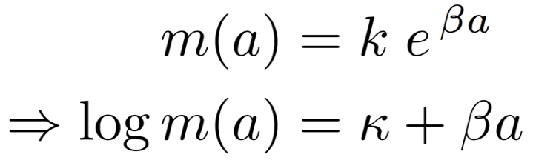
Step 2: Predicting Mortality Rates at Older Ages
To calculate life expectancy, need estimates of mortality rates beyond age 76
Gompertz (1825) documented a robust empirical regularity: mortality rates grow exponentially with age
Notes:
23

Slide 24
CDC NCHS Mortality Rates by Gender in the United States in 2001
0
Age 76
-2
Log Mortality Rate
-4
-6
40
50
60
70
80
90
100
Age in Years
Men
Women

Slide 25
Log Mortality Rates
For Men at 5th and 95th Percentiles
-2
-4
Log Mortality Rate
-6
-8
40
50
60
70
80
90
Age in Years
Data: p5
Gompertz: p5
Data: p95
Gompertz: p95

Slide 26
Log Mortality Rates
For Men at 5th and 95th Percentiles
-2
Age 65
-4
Log Mortality Rate
-6
Medicare Eligibility
[Finkelstein and McKnight 2008,
Card, Dobkin, Maestas 2009]
-8
40
50
60
70
80
90
Age in Years
Data: p5
Gompertz: p5
Data: p95
Gompertz: p95
Notes:
Note: Gompertz aggregation approximation
Note: Estimate Gompertz models using MLE (GLM with log link and a single covariate, age)

Slide 27
Survival Curves for Men at 5th and 95th Percentiles
100
Age 63
Age 76
Age 90
80
60
Survival Rate (%)
40
Income Measured
Income
at Age a-2
Measured
at Age 61
20
Gompertz
0
Extrapolation
40
60
80
100
120
Age in Years (a)
Data: p5
Gompertz: p5
Data: p95
Gompertz: p95

Slide 28
Survival Curves for Men at 5th and 95th Percentiles
100
Age 63
Age 76
Age 90
80
60
Survival Rate (%)
40
Income Measured
Income
NCHS and SSA
at Age a-2
Measured
Estimates
at Age 61
(constant across
20
income groups)
Gompertz
0
Extrapolation
40
60
80
100
120
Age in Years (a)
Data: p5
Gompertz: p5
Data: p95
Gompertz: p95

Slide 29
Step 3: Race and Ethnicity Adjustment
Final step: adjust for racial and ethnic differences in life expectancy
CDC statistics show that for males, life exp. of whites is 3.8 years higher than blacks and 2.7 years lower than Hispanics
Race shares vary across income groups and especially across areas, potentially biasing raw comparisons
Perform race (and ethnicity) adjustment to answer the question:
“What would life expectancy be if each income group and area had the same black, Hispanic and Asian shares as the U.S. population as a whole at age 40?”
Notes:
29
CDC source: http://www.cdc.gov/nchs/data/hus/2014/016.pdf

Slide 30
Race and Ethnicity Adjustment
“What would life expectancy be if each income group and area had the same black, Hispanic and Asian shares as the U.S. population as a whole at age 40?”
Construct race-adjusted measures of life expectancy in four steps:
Estimate differences in mortality by race controlling for income using data from National Longitudinal Mortality Study
Assume racial differences do not vary across areas
Notes:
30

Slide 31
Log Mortality Rates vs. Age by Race and Ethnicity in NLMS Data
Men, 1973-2011
-3
-4
Log Mortality Rate
-5
-6
Black
White
Hispanic
-7
Asian
40-44
45-49
50-54
55-59
60-64
65-69
Age Bin in Years
Notes:
eFig 5a

Slide 32
Race and Ethnicity Adjustment
“What would life expectancy be if each income group and area had the same black, Hispanic and Asian shares as the U.S. population as a whole at age 40?”
Construct race-adjusted measures of life expectancy in four steps:
Estimate differences in mortality by race controlling for income using data from National Longitudinal Mortality Study
Estimate racial demographics in each income group and area using Census data
Recover mortality rates by race in each income group and area from aggregate rates in tax data and race differences from NLMS
Calculate life expectancy that would prevail if racial demographics were the same as the national demographics at age 40 (for men, 12% black, 12% Hispanic, 4% Asian)
Notes:
32

Slide 33
Part 2: National Statistics on Income and Life Expectancy

Slide 34
Expected Age at Death vs. Household Income Percentile
For Men at Age 40
90
85
Expected Age at Death for 40 Year Olds in Years
80
75
70
0
20
$25k
40
$47k
60
$74k
80
$115k
100
$2.0M
Household Income Percentile

Slide 35
Expected Age at Death vs. Household Income Percentile
For Men at Age 40
90
Top 1%:
87.3 Years
85
Expected Age at Death for 40 Year Olds in Years
80
75
Bottom 1%:
72.7 Years
70
0
20
$25k
40
$47k
60
$74k
80
$115k
100
$2.0M
Household Income Percentile

Slide 36
U.S. Life Expectancies by Percentile in Comparison to
Mean Life Expectancies Across Countries
United States - P100
San Marino
United States - P50
Canada
United Kingdom
United States - P25
China
Libya
Pakistan
United States - P1
Sudan
Iraq
India
Zambia
Lesotho
60
65
70
75
80
85
90
Expected Age at Death for 40 Year Old Men

Slide 37
Expected Age at Death vs. Household Income Percentile
By Gender at Age 40
90
Women
85
Men
Expected Age at Death for 40 Year Olds in Years
80
75
Women, Bottom 1%: 78.8
Women, Top 1%: 88.9
Men, Bottom 1%: 72.7
70
Men, Top 1%: 87.3
0
20
40
60
80
100
Household Income Percentile

Slide 38
Expected Age at Death vs. Household Income Percentile
By Gender at Age 40
90
Top 1% Gender Gap
1.6 years
85
Expected Age at Death for 40 Year Olds in Years
80
75
Bottom 1% Gender Gap
6.1 years
Women, Bottom 1%: 78.8
Women, Top 1%: 88.9
Men, Bottom 1%: 72.7
70
Men, Top 1%: 87.3
0
20
40
60
80
100
Household Income Percentile
Men
Women

Slide 39
Expected Age at Death vs. Individual Income Percentile
By Gender at Age 40
90
85
Expected Age at Death for 40 Year Olds in Years
80
75
70
0
20
40
60
80
100
Income Percentile
Men
Women

Slide 40
Time Trends
How are gaps in life expectancy changing over time?
Relevant for understanding distributional consequences of various policies, e.g. increasing age of eligibility for social security
Some studies have found that gap between low- and high-SES groups has grown [Waldron 2007, Meara et al. 2008, Goldring et al. 2015]
Some evidence of declining life expectancy for low-SES subgroups, but results debated [Olshansky et al. 2012, Bound et al 2015]
Notes:
40

Slide 41
Trends in Expected Age at Death by Income Quartile in the United States
For Men Age 40, 2001-2014
90
Annual Change = 0.20 (0.17, 0.24)
85
Annual Change = 0.18 (0.15, 0.20)
Expected Age at Death for 40 Year Olds in Years
Annual Change = 0.12 (0.08, 0.16)
80
Annual Change = 0.08 (0.05, 0.11)
75
2000
2005
2010
2015
Year
1st Quartile
2nd Quartile
3rd Quartile
4th Quartile

Slide 42
Trends in Expected Age at Death by Income Quartile in the United States
For Women Age 40, 2001-2014
90
Annual Change = 0.23 (0.20, 0.25)
88
Annual Change = 0.25 (0.22, 0.28)
Expected Age at Death for 40 Year Olds in Years
Annual Change = 0.17 (0.13, 0.20)
86
84
Annual Change = 0.10 (0.06, 0.13)
82
2000
2005
2010
2015
Year
1st Quartile
2nd Quartile
3rd Quartile
4th Quartile

Slide 43
Change in Life Expectancy Per Year by Income Ventile, Men
0.4
0.3
0.2
Change per Year in Expected Age at Death in Years
0.1
0
-0.1
0
5
10
15
20
$30k
$60k
$101k
$683k
Household Income Ventile

Slide 44
Change in Life Expectancy Per Year by Income Ventile, Men
0.4
0.3
0.2
Change per Year in Expected Age at Death in Years
0.1
0
No gain in life expectancy
over past 14 years
-0.1
0
5
10
15
20
$30k
$60k
$101k
$683k
Household Income Ventile

Slide 45
Change in Life Expectancy Per Year by Income Ventile, Women
0.4
0.3
0.2
Change per Year in Expected Age at Death in Years
0.1
0
No gain in life expectancy
for women either
-0.1
0
5
10
15
20
$27k
$54k
$95k
$653k
Household Income Ventile

Slide 46
Part 3: Local Area Variation

Slide 47
Local Area Variation
Long literature analyzing geographical differences in mortality [e.g., Fuchs (1974), Murray et al. 2006, Berkman et al 2014]
We analyze geographic variation at the level of commuting zones
Commuting zones are aggregations of counties (analogous to metro areas)
Also report county-level results
Prior work has not disaggregated geographical variation in mortality by income
This turns out to be quite important…
Notes:
47

Slide 48
Race-Adjusted Expected Age at Death vs. Household Income
for Men in Selected Major Cities
90
85
Expected Age at Death for 40 Year Olds in Years
80
New York City
San Francisco
Dallas
75
Detroit
70
0
5
10
15
20
$30k
$60k
$101k
$683k
Household Income Ventile

Slide 49
Race-Adjusted Expected Age at Death vs. Household Income
for Women in Selected Major Cities
90
85
New York City
San Francisco
Expected Age at Death for 40 Year Olds in Years
80
Dallas
Detroit
75
70
0
5
10
15
20
$27k
$54k
$95k
$653k
Household Income Ventile

Slide 50
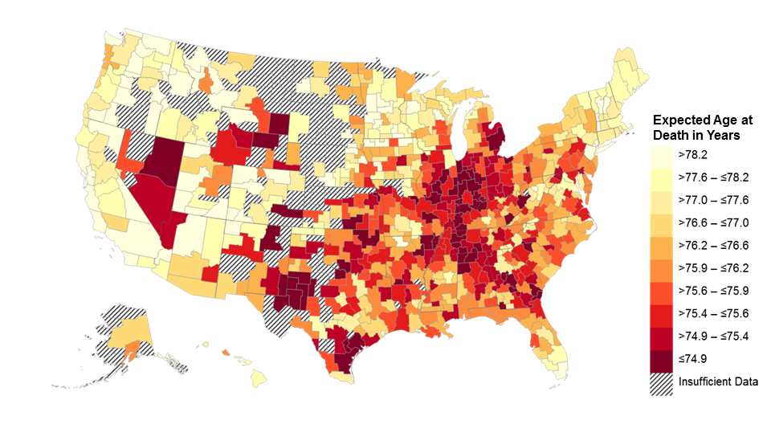
Race-Adjusted Expected Age at Death for 40 Year Old Men
Bottom Quartile of U.S. Income Distribution
Note: Lighter Colors Represent Areas with Higher Life Expectancy

Slide 51
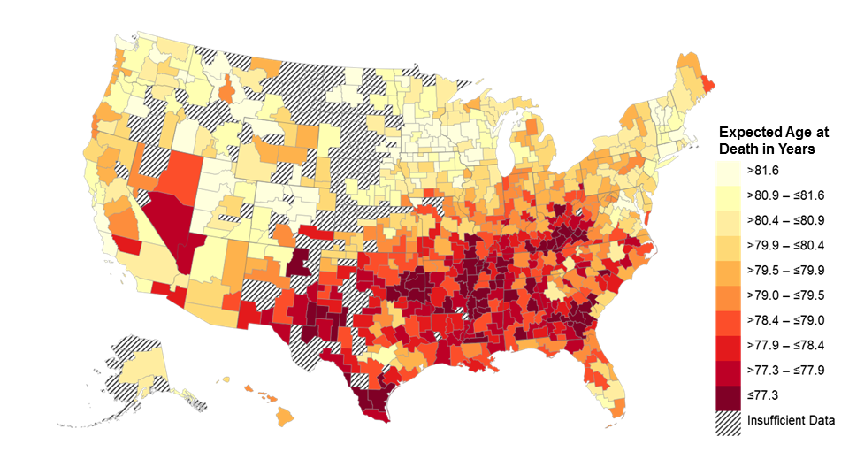
Race-Adjusted Expected Age at Death for 40 Year Old Men
Pooling All Income Groups
Note: Lighter Colors Represent Areas with Higher Life Expectancy

Slide 52
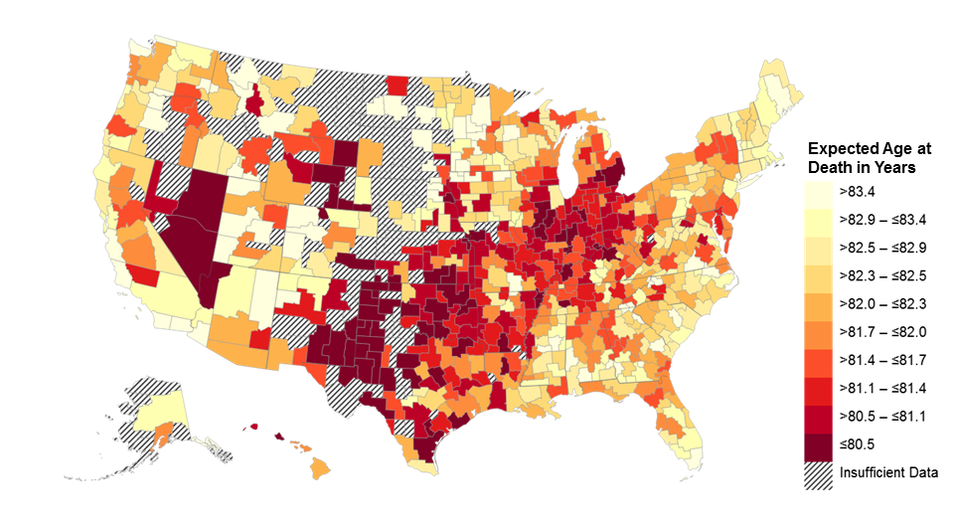
Race-Adjusted Expected Age at Death for 40 Year Old Women
Bottom Quartile of U.S. Income Distribution
Note: Lighter Colors Represent Areas with Higher Life Expectancy

Slide 53
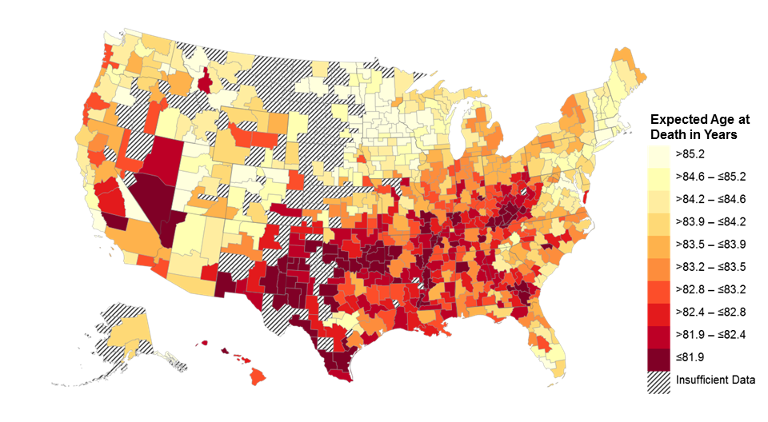
Race-Adjusted Expected Age at Death for 40 Year Old Women
Pooling All Income Groups
Note: Lighter Colors Represent Areas with Higher Life Expectancy

Slide 54
Race-Adjusted Expected Age at Death for 40 Year Olds in Bottom Quartile
Top 10 and Bottom 10 CZs Among 100 Largest CZs
Top 10 CZs |  |  |  |  | Bottom 10 CZs
Rank | CZ |  | Expected Age at Death |  | Rank | CZ | Expected Age at Death
1 | New York, NY |  | 81.8 (81.6, 82.0) |  | 91 | San Antonio, TX | 78.0 (77.6, 78.4)
2 | Santa Barbara, CA |  | 81.7 (81.3, 82.1) |  | 92 | Louisville, KY | 77.9 (77.7, 78.2)
3 | San Jose, CA |  | 81.6 (81.2, 82.0) |  | 93 | Toledo, OH | 77.9 (77.6, 78.2)
4 | Miami, FL |  | 81.2 (80.9, 81.6) |  | 94 | Cincinnati, OH | 77.9 (77.7, 78.1)
5 | Los Angeles, CA |  | 81.1 (80.9, 81.4) |  | 95 | Detroit, MI | 77.7 (77.5, 77.8)
6 | San Diego, CA |  | 81.1 (80.8, 81.4) |  | 96 | Tulsa, OK | 77.6 (77.4, 77.9)
7 | San Francisco, CA |  | 80.9 (80.6, 81.3) |  | 97 | Indianapolis, IN | 77.6 (77.4, 77.8)
8 | Santa Rosa, CA |  | 80.8 (80.5, 81.2) |  | 98 | Oklahoma City, OK | 77.6 (77.3, 77.8)
9 | Newark, NJ |  | 80.7 (80.5, 80.9) |  | 99 | Las Vegas, NV | 77.6 (77.4, 77.8)
10 | Port St. Lucie, FL |  | 80.7 (80.5, 80.9) |  | 100 | Gary, IN | 77.4 (77.1, 77.8)
Note: 95% confidence intervals shown in parentheses

Slide 55
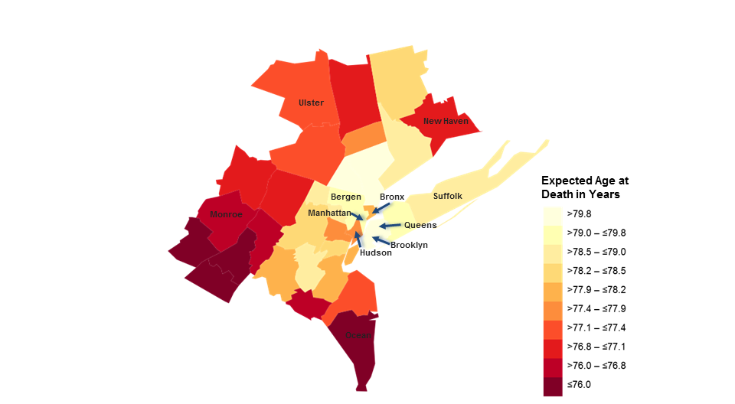
Race-Adjusted Expected Age at Death for 40 Year Old Men in Bottom Quartile
By County in the New York Area
Note: Lighter Colors Represent Areas with Higher Life Expectancy
Notes:
eFig 12a

Slide 56
Local Area Variation in Trends
Next, analyze how trends in life expectancy vary across areas
Notes:
56

Slide 57
Change in Race-Adjusted Expected Age at Death in Bottom Quartile
Birmingham, AL
90
Annual Change = 0.37 (0.20, 0.55)
85
Expected Age at Death in Years
80
75
Annual Change = 0.20 (0.07, 0.35)
70
2001
2014
Year
Men
Women

Slide 58
Change in Race-Adjusted Expected Age at Death in Bottom Quartile
Birmingham, AL
Tampa, FL
90
Annual Change = 0.37 (0.20, 0.55)
Annual Change = -0.18 (-0.30, -0.06)
85
Women
Expected Age at Death in Years
80
Men
75
Annual Change = 0.20 (0.07, 0.35)
Annual Change = -0.16 (-0.25, -0.07)
70
2001
2014
2001
2014
Year
Men
Women

Slide 59
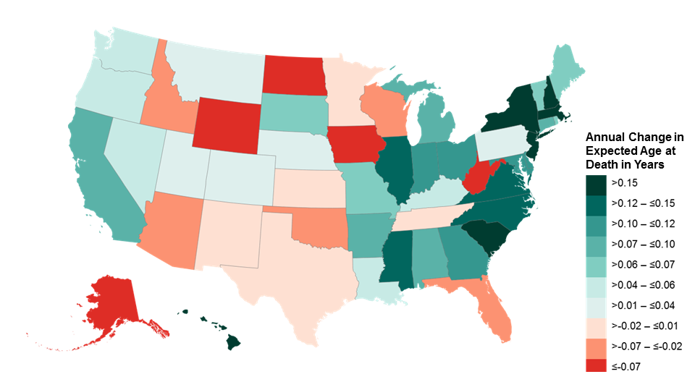
Annual Change in Race-Adjusted Expected Age at Death
for Men in Bottom Quartile by State
Note: Turquoise represents rising life expectancy; red represents falling life expectancy

Slide 60
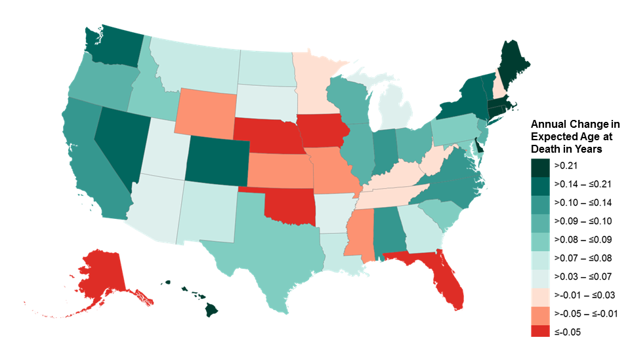
Annual Change in Race-Adjusted Expected Age at Death
for Women in Bottom Quartile by State
Note: Turquoise represents rising life expectancy; red represents falling life expectancy

Slide 61
Change in Race-Adjusted Expected Age at Death in Bottom Quartile
Top 10 and Bottom 10 CZs Among 100 Largest CZs
Top 10 CZs |  |  |  | Bottom 10 CZs
Rank | CZ | Change over Decade |  | Rank | CZ | Change over Decade
1 | Toms River, NJ | 3.8 (2.4, 5.2) |  | 91 | Cape Coral, FL | -0.7 (-2.1, 0.6)
2 | Birmingham, AL | 2.9 (1.8, 4.1) |  | 92 | Miami, FL | -0.7 (-1.4, -0.1)
3 | Richmond, VA | 2.6 (1.3, 3.9) |  | 93 | Tucson, AZ | -0.7 (-2.0, 0.5)
4 | Syracuse, NY | 2.5 (1.1, 4.0) |  | 94 | Albuquerque, NM | -0.8 (-2.2, 0.6)
5 | Cincinnati, OH | 2.4 (1.5, 3.4) |  | 95 | Sarasota, FL | -0.8 (-2.0, 0.3)
6 | Fayetteville, NC | 2.4 (1.0, 3.8) |  | 96 | Des Moines, IA | -1.0 (-3.0, 0.8)
7 | Springfield, MA | 2.3 (0.6, 4.1) |  | 97 | Bakersfield, CA | -1.2 (-2.8, 0.3)
8 | Gary, IN | 2.2 (0.8, 3.8) |  | 98 | Knoxville, TN | -1.2 (-2.6, 0.1)
9 | Scranton, PA | 2.1 (0.8, 3.4) |  | 99 | Pensacola, FL | -1.5 (-3.0, -0.2)
10 | Honolulu, HI | 2.1 (0.5, 3.8) |  | 100 | Tampa, FL | -1.7 (-2.5, -0.9)
Note: 95% confidence intervals shown in parentheses

Slide 62
Part 4: Correlates of Spatial Variation in Mortality

Slide 63
Why Does Life Expectancy Vary Across Areas?
Finally, we characterize the features of areas with high vs. low life expectancy conditional on income
Analysis is purely correlational: does not directly identify causal pathways that can be manipulated to change mortality
Begin by assessing measures of health behavior using data from the BRFSS [Fuchs 1974]
Notes:
63

Slide 64
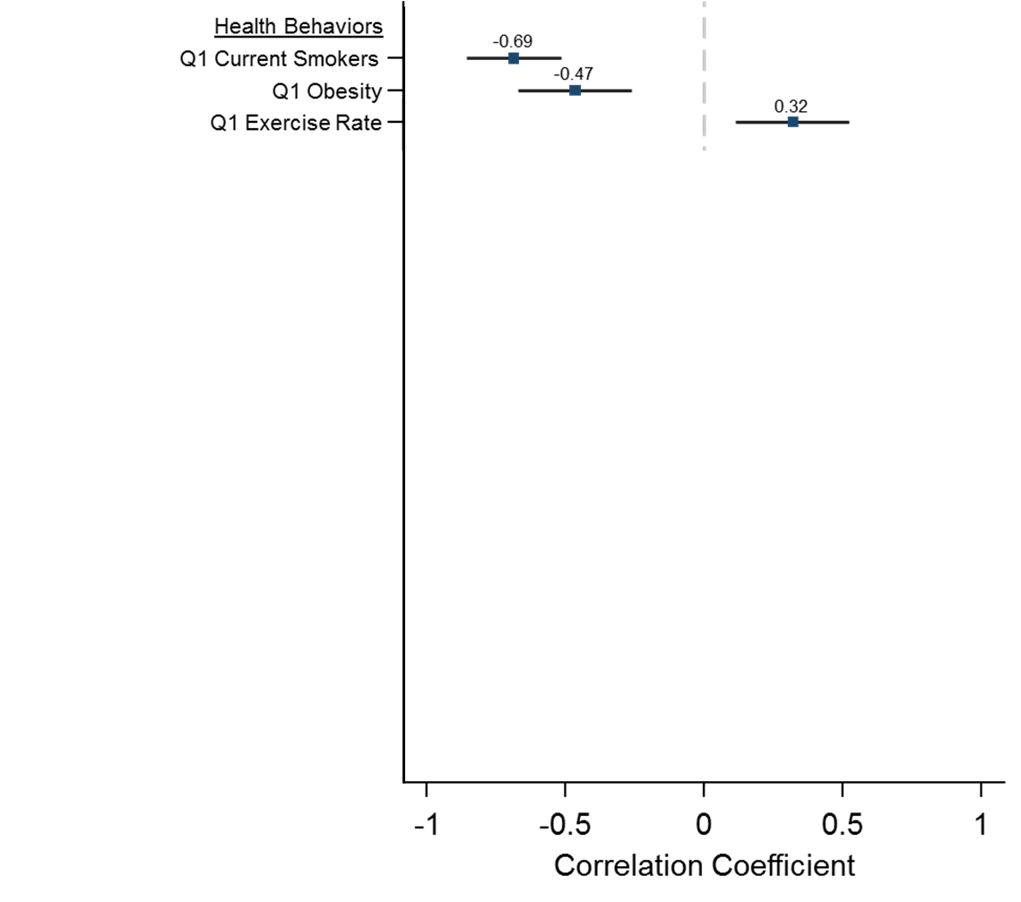
Correlations of Expected Age at Death with Health and Social Factors
For Individuals in Bottom Quartile of Income Distribution

Slide 65
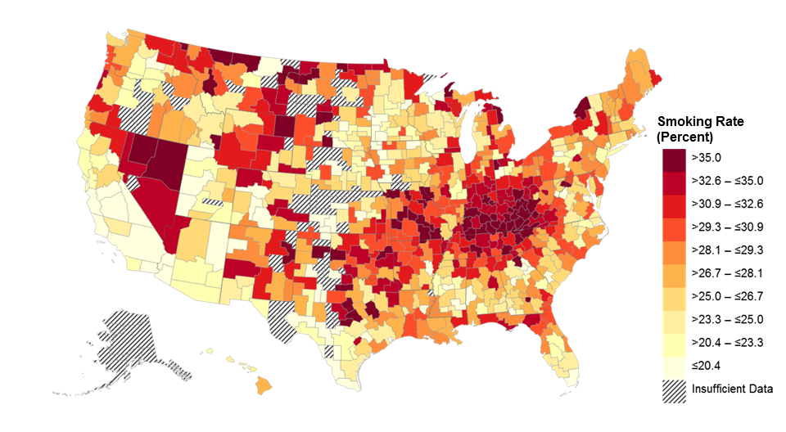
Smoking Rates by Commuting Zone
in Bottom Quartile
Note: Lighter Colors Represent Areas Lower Smoking Rates

Slide 66
Why Does Life Expectancy Vary Across Areas?
Variation in life expectancy among low income individuals is strongly related to variation in health behaviors
What generates spatial variation in health behaviors and outcomes?
We focus here on four theories discussed widely in literature:
Health care [Fisher et al. 1993, Almond et al. 2010, Doyle et al. 2015]
Environmental factors [Dockery et al. 1993, Currie and Neidell 2005]
Income inequality [Lynch et al.1998, Deaton and Lubotsky 2001, Wilkinson 2005]
Economic decline [Ruhm 2000, Sullivan and von Wachter 2009]
Notes:
66

Slide 67
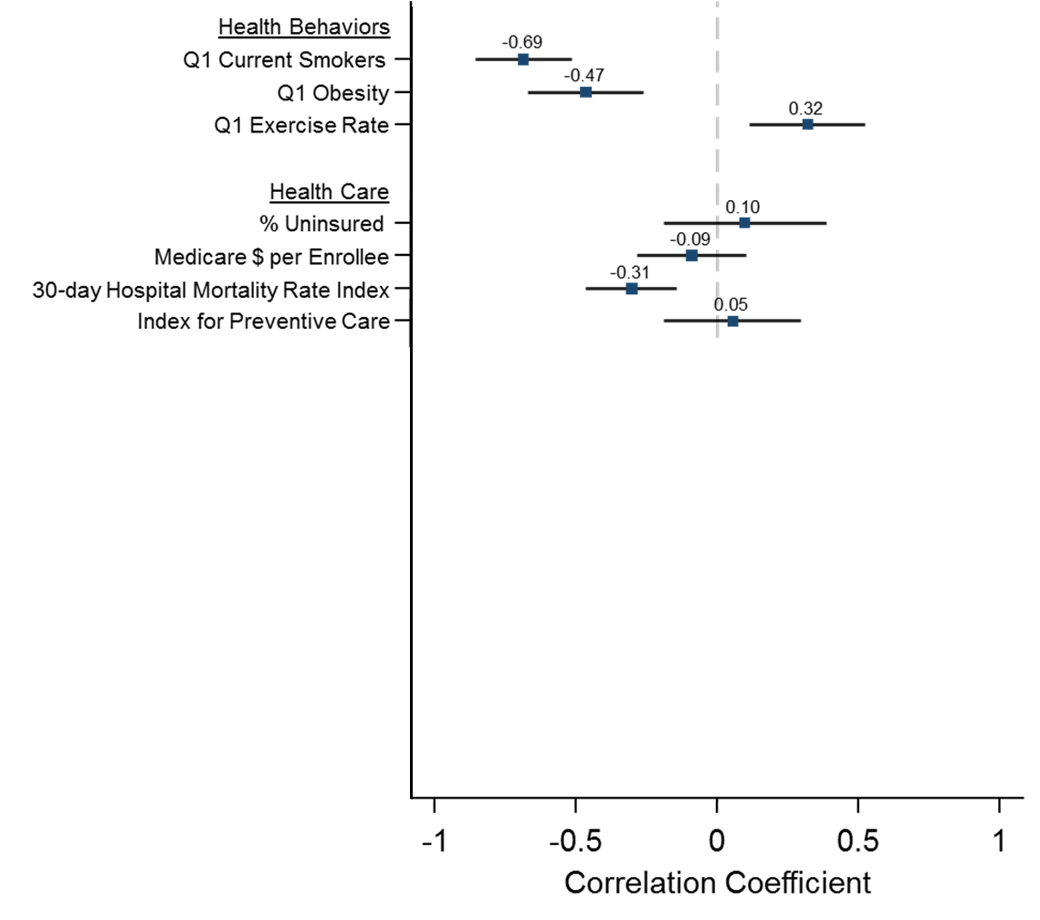
Correlations of Expected Age at Death with Health and Social Factors
For Individuals in Bottom Quartile of Income Distribution

Slide 68
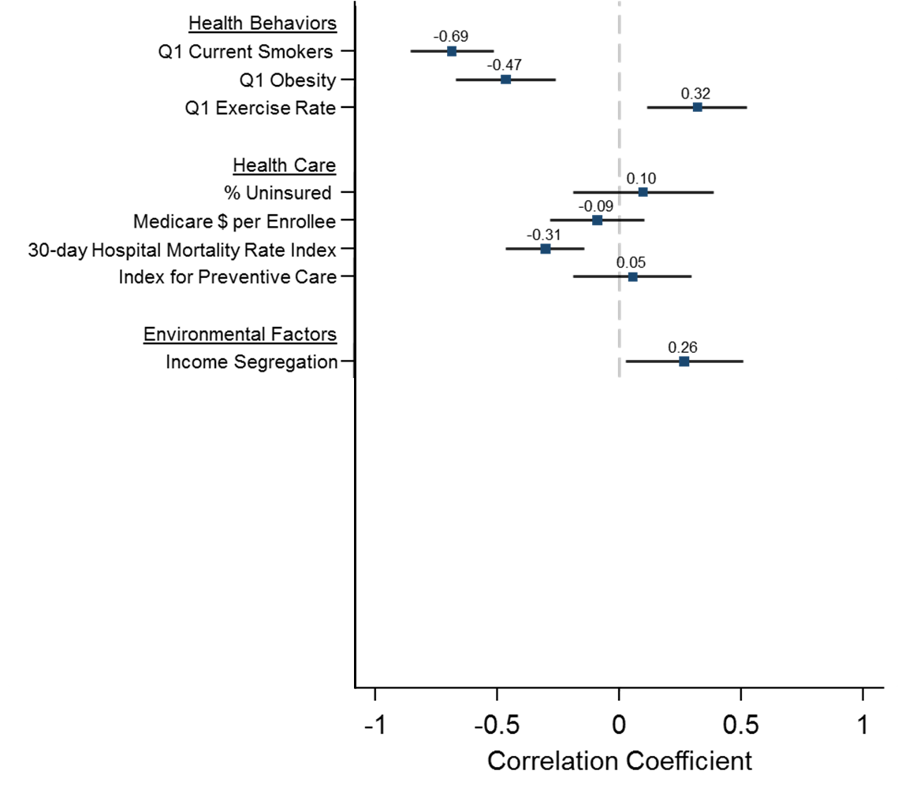
Correlations of Expected Age at Death with Health and Social Factors
For Individuals in Bottom Quartile of Income Distribution

Slide 69
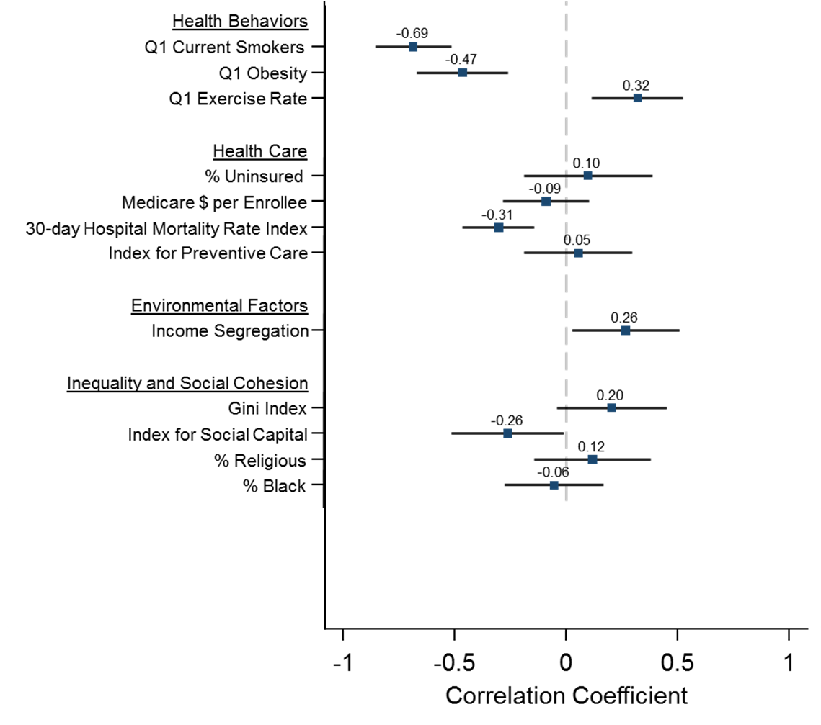
Correlations of Expected Age at Death with Health and Social Factors
For Individuals in Bottom Quartile of Income Distribution

Slide 70
Expected Age at Death vs. Household Income
For Men at Age 40
90
85
Expected Age at Death for 40 Year Olds in Years
80
75
70
0
100000
200000
300000
400000
500000
Mean Household Income by Percentile ($)

Slide 71
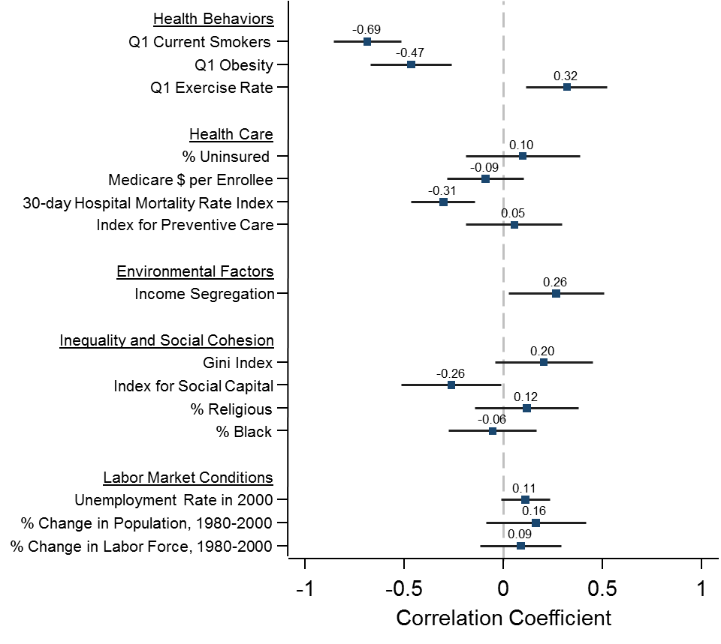
Correlations of Expected Age at Death with Health and Social Factors
For Individuals in Bottom Quartile of Income Distribution

Slide 72
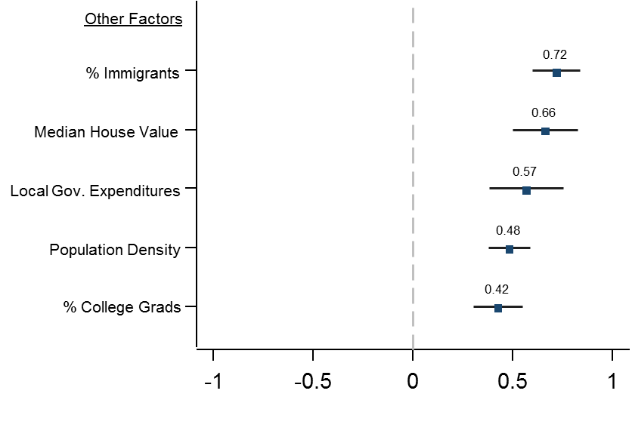
Correlations of Expected Age at Death with Other Factors
For Individuals in Bottom Quartile of Income Distribution

Slide 73
Correlations: Summary
General pattern: Low-income people in affluent, educated cities live longer (and have healthier behaviors)
Why is this the case?
Spillovers from rich to poor: regulation, public revenues/transfers
Exposure to people with healthier behaviors
Sorting: low-income people who live in expensive cities are a selected group with different characteristics
Ongoing work by other researchers will shed light on these alternative mechanisms
Notes:
73

Slide 74
Conclusion
Inequality in life expectancy is large and growing, but not immutable: some areas in the U.S. have relatively small and shrinking gaps
Differential trends imply that indexing eligibility for Social Security and Medicare to mean life expectancy will affect progressivity
Reducing health disparities likely to require local policy interventions
Ex: targeted efforts to improve health among low-income individuals in Las Vegas, Tulsa, and Oklahoma City
Changing health behaviors at local level likely to be important
Statistics constructed here (available at www.healthinequality.org) provide a tool to monitor local progress and identify solutions
Notes:
74

